Slide 1
Clustering Cities in Gujarat State of India based on Demographic, Education and Location Data
By Phenil Buch

Slide 2
Introduction
Gujarat is a state on the western coast of India with a coastline of 1,600 km (990 mi) and a population in excess of 60 million. It is the sixth largest Indian state by area and the ninth largest state by population. The economy of Gujarat is the fifth-largest state economy in India with ₹14.96 lakh crore (US$210 billion) in gross domestic product and a per capita GDP of ₹157,000 (US$2,200).
As you can see from the figures, Gujarat is a great state to live in.

Slide 3
Business Problem
When we think of this from the perspective of an immigrant, we can ask the question：
1. Where is/are the best city/cities to live in Gujarat?
2. How can the cities be categorized according to demographic, educational and location data?

Slide 4
Data Used
List of Cities (District Headquarters) from District Table - https://en.wikipedia.org/wiki/List_of_districts_of_Gujarat
Kaggle Dataset - 2015-16-District-wise Education Data India - https://www.kaggle.com/rajanand/education-in-india
Geo Location Data - Geocoder Library/API
Location Data - Total Venues per City - Foursquare API

Slide 5
Methodology
Obtaining Data and Deciding What Features to Keep
Combining Data from Various Sources and Data Wrangling
KMeans clustering - Clustering the 20 cities of Gujarat State

Slide 6
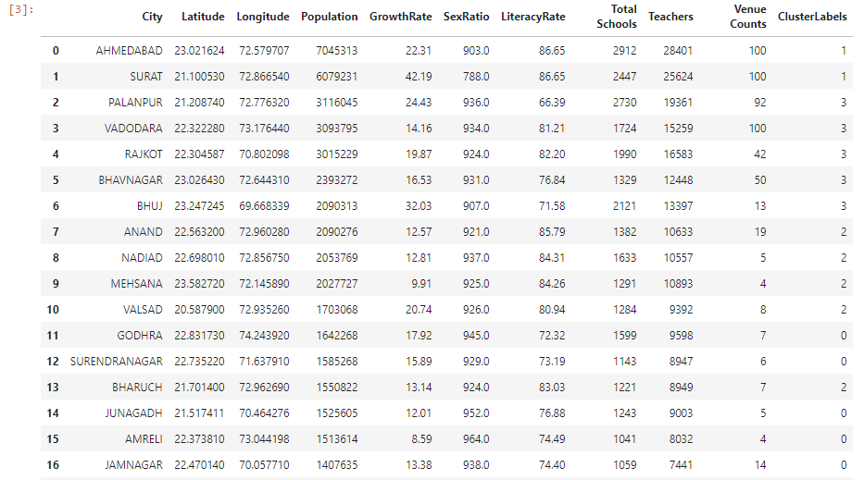
Final DataFrame

Slide 7
Results – Clustered Cities
Cluster 0 - GODHRA, SURENDRANAGAR, JUNAGADH, AMRELI, JAMNAGAR, HIMMATNAGAR, PATAN
Cluster 1 - AHMEDABAD, SURAT
Cluster 2 - ANAND, NADIAD, MEHSANA, VALSAD, BHARUCH, GANDHINAGAR
Cluster 3 - PALANPUR, VADODARA, RAJKOT, BHAVNAGAR, BHUJ

Slide 8
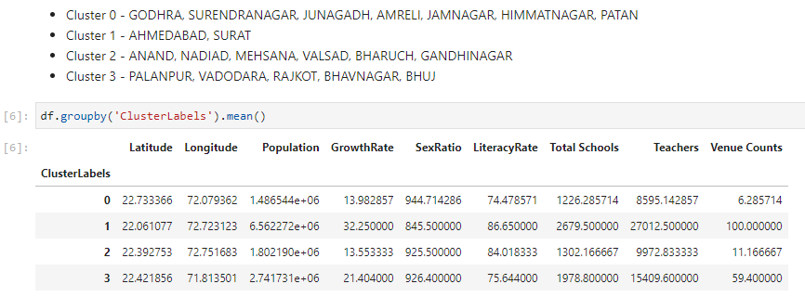
Results – Cluster Mean Values

Slide 9
Results – Cluster Descriptions based on Cluster Mean Values
(Tier 0 Cities) - Cluster Label 0 - Low Population, High Sex Ratio, Low Growth Rate, Low Literacy Rate, Low Schools and Teachers, Low Venue Counts
(Tier 1 Cities) - Cluster Label 2 - Low Population, High Sex Ratio, Low Growth Rate, High Literacy Rate, Low Schools and Teachers, Low Venue Counts
(Tier 2 Cities) - Cluster Label 3 - Medium Population, High Sex Ratio, Medium Growth Rate, Low Literacy Rate, Medium Schools and Teachers, Medium Venue Counts
(Tier 3 Cities) - Cluster Label 1 - High Population, Low Sex Ratio, High Growth Rate, High Literacy Rate, High Schools and Teachers, High Venue Counts

Slide 10
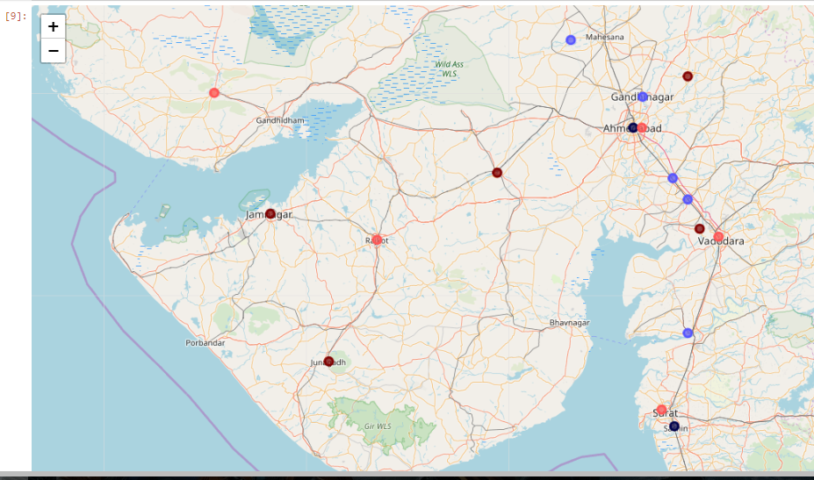

Slide 11
Some Observations Based on Correlation Coefficients of the DataFrame
No Feature is directly correlated to the Cluster Label
High Population equals Higher number of schools, teachers and venue counts
There is a negative correlation between High Population and Sex Ratio of Male:Female
Venue Counts has the largest correlation value for the Cluster Label

Slide 12
Conclusion
In this project, I grouped cities of the Gujarat State of India based on various kinds of data including Demographic Data, Education Data and Location Data. I used the K-Means algorithm as part of this clustering study.
The Latitude, Longitude Co-ordinates for the cities obtained from using the Geocoder library in Python were not accurate for some cities. This led to the Foursquare API providing inaccurate venue counts for some cities.
The venue counts were just one feature among the seven features used to cluster the data and might not have had as much of an influence on the final cluster labels as required for this project.
The city clusters met most of my personal perceptions as highly developed cities were placed in one cluster whereas the not-so-developed cities were grouped together in a single cluster.

Slide 13
Thank you

